Slide 1
MIS 3301 Intro to Business Programming Logic
Introduction to Computers & Programming
Mrs. Nancy G. Sánchez

Slide 2
Outline
Introduction to Computers & Programming
Hardware
Software
Storing Data
Programming Languages
Installing Python & Using IDLE

Slide 3
Hardware

Slide 4
Hardware
Physical components of information technology
Central Processing Unit (CPU)
Main Memory - RAM
Secondary storage devices
Input devices
Output devices

Slide 5
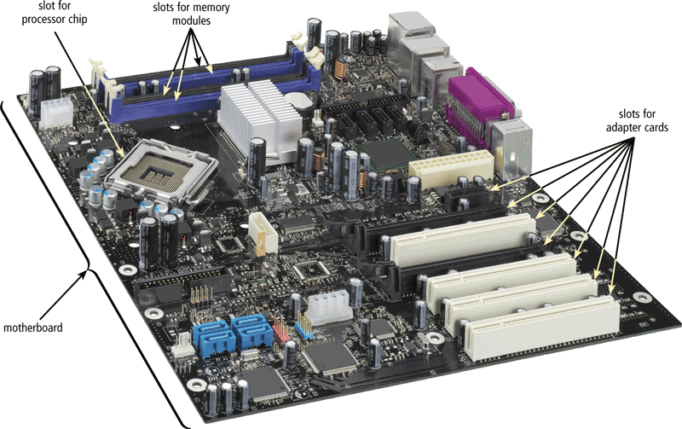
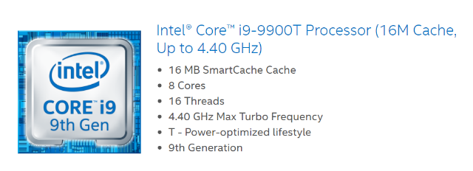
Central Processing Unit - CPU
CPU executes the instructions of a computer program.
When buying a new computer:
Manufacturer
Brand
Speed = Ghz (billion cycles/second)
# Cores
Hyper-Threading
Microprocessor

Slide 6
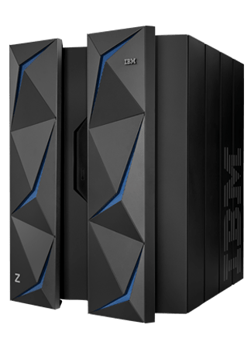
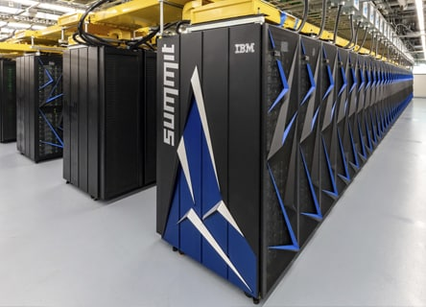
Central Processing Unit - CPU
Mainframe
Supercomputers
IBM z14™
IBM Summit

Slide 7
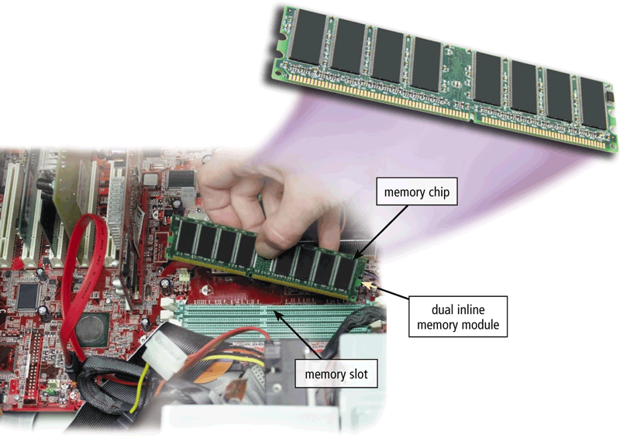
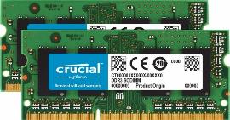
Main Memory - Random Access Memory (RAM)
RAM is volatile memory
Contents?
When buying a new computer:
Capacity
Current: ____ GB
Expandable to: ____ GB
Speed
DDR3
DDR4 – 2x faster, 25% less power

Slide 8


Types of Volatile Memory
Volatile Memory
RAM
Cache

Slide 9
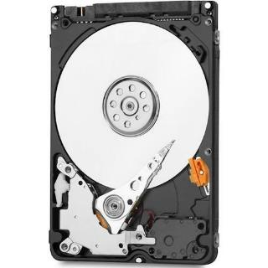
Secondary Storage Devices – Hard Drive
Hard Drive (HD, HDD)
Non-Volatile Memory
Composed of:
Platters
Read-write heads
Sectors
Tracks
Less expensive
Issues
Fragmentation
Because it has moving parts:
Heat
Failure
Western Digital
Blue series
320GB
Internal SATA Hard Drive
for Laptops

Slide 10
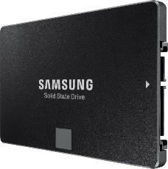
Secondary Storage Devices – Solid State Drives
Solid State Drive (SSD)
Non-Volatile Memory
It’s a circuit board with flash memory
No moving parts
Uses less power
Faster than HD
More reliable
Samsung - 860 EVO 1TB Internal SATA Solid State Drive.

Slide 11
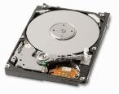
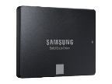
Secondary Storage Devices
When buying a new computer:
Capacity
GB?
TB?
Speed
 | Hard Disk Drive (HDD) | Solid State Drive (SDD)
Cost | Less
Speed |  | Faster
Noise |  | Quieter
Ruggedness |  | Better

Slide 12
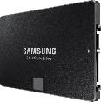

Types of Non-Volatile Memory
Nonvolatile
Hard Drive
Flash Memory
Uses Solid State Electronics
Used in:
Solid State Drives
USB Drives – i.e. flash drives, memory sticks
MP3 Players
Digital cameras
Medical electronics
Smart devices
SSD
HDD

Slide 13
Input & Output Devices
Input Device
Keyboard
Mouse
Touchpad
Microphone
Scanner
Digital camera
Monitor
Output Device
Monitor
Printer
Speakers

Slide 14


Hardware Components - a logical view
Calculations
Comparisons
I/O operations
etc.
Processor
(CPU)
Result
Input
Devices
RAM
Output
Devices
Open software
Open files
Save files
Storage
Devices

Slide 15
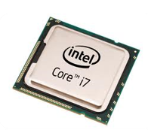
How A Program Works
The fetch-decode-execute cycle
Fetch the next instruction in the program
Decode the instruction to determine which operation to perform
Execute the instruction

Slide 16
Software

Slide 17
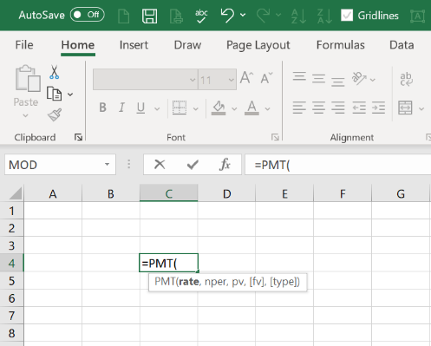
Software
Software is a collection of programs that tell a computer what to do
A program is a collection of statements/instructions that a computer follows to perform a task.
Types of Software
System Software
Application Software

Slide 18
System Software
Operating System – Windows, macOS, Linux
Software that controls internal operation of the computer’s hardware.
Manages all devices connected to the computer.
Allows data to be saved to & retrieved from storage devices.
Allows other programs to run on the computer.
Utility Program
Performs a specialized task that enhances the computers operations or safeguards data.

Slide 19
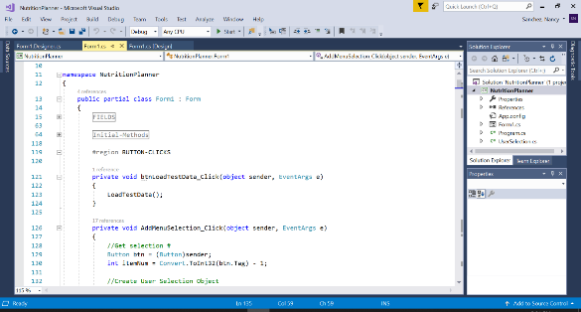
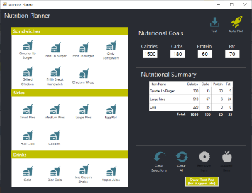
System Software cont.
Software Development Tools
Integrated Development Environments (IDE)
includes a text editor, debugger, and other useful programming tools
Visual Studio
XCode
IDLE
Visual Studio

Slide 20

Application Software
Application Software – software for end-users
Productivity tools
Email programs
Web browsers
Business applications
Educational software
Mobile apps

Slide 21
Storing Data

Slide 22
Bits & Bytes
Data is stored in computer memory as a sequence of 1s and 0s.
Each storage location in memory is a Byte
A byte is made of 8 smaller locations known as Bits (binary digit)
Bit – a tiny electrical component that can hold a positive or negative charge
-
OFF
+ ON
-
OFF
-
OFF
+ ON
+ ON
-
OFF
+ ON
Unit | Abbrev | Approx. Amount | Actual
Byte | B | 1
Kilo | KB | 1 Thousand | 2¹⁰
Mega | MB | 1 Million | 2²⁰
Giga | GB | 1 Billion | 2³⁰
Tera | TB | 1 Trillion | 2⁴⁰
Peta | PB | 1 Quadrillion | 2⁵⁰
0
1
0
0
1
1
0
1
A BYTE can hold: a small number → 77
-
OFF
+ ON
-
OFF
-
OFF
+ OFF
+ OFF
-
OFF
+ ON
0
1
0
0
0
0
0
1
A BYTE can hold: a single letter → A

Slide 23

Understanding Binary – Why 8 bits?
Formula:
2^{n} = _____________
ON
OFF
n → number of bits
ON
ON
2⁸
= 256 numbers
OFF
OFF
It can hold a small number in
the range 0 - 255
ON
OFF
OFF
ON

Slide 24
Binary Numbering System
Binary Numbering System
all numbers are written as a series of ones and zeros.
Know how to convert:
A Decimal number to a Binary number
A Binary number to a Decimal number
Decimal number
Binary number
129
1
0
0
0
0
0
0
1

Slide 25
Storing Numbers - Converting Decimal Numbers to Binary
Given a Decimal Number…
Determine its Binary Number
8
Number/2 | Quotient | Remainder
8/2 | 4 | 0
4/2 | 2 | 0
2/2 | 1 | 0
1/2 | 0 | 1
Steps:
1. Divide the number by 2 → 8/2
2. Determine the quotient → 4 (use this in the next iteration)
3. Determine the remainder → 0 (this is the binary digit)
4. Repeat steps 1-3 until the quotient is equal to 0
↑
Write from
bottom up
8₁₀ = 1000₂
0
0
0
0
1
0
0
0

Slide 26
Exercise
Given a Decimal Number…
Determine its Binary Number
19
Number/2 | Quotient | Remainder
↑
19₁₀ = ???₂

Slide 27
Exercise - Solution
Given a Decimal Number…
Determine its Binary Number
19
Number/2 | Quotient | Remainder
19/2 | 9 | 1
9/2 | 4 | 1
4/2 | 2 | 0
2/2 | 1 | 0
1/2 | 0 | 1
↑
19₁₀ = 10011₂
0
0
0
1
0
0
1
1

Slide 28
Storing Numbers - Converting Binary Numbers to Decimal
Given a Binary Number…
0
1
0
0
1
1
0
1
2⁷
2⁶
2⁵
2⁴
2³
2²
2¹
2⁰
First, know the
positional values
=128
=64
=32
=16
=8
=4
=2
=1
Determine its Numerical Value…
= 1 + 4 + 8 + 64
= 77
77

Slide 29
Exercise
Given a Binary Number…
Determine its Numerical Value…
0
0
0
1
0
1
0
1
?
1
1
1
1
0
0
0
0
?

Slide 30
Exercise - Solution
Given a Binary Number…
Determine its Numerical Value…
0
0
0
1
0
1
0
1
= 1 + 4 + 16
= 21
21
2⁷
2⁶
2⁵
2⁴
2³
2²
2¹
2⁰
=128
=64
=32
=16
=8
=4
=2
=1
1
1
1
1
0
0
0
0
= 16 + 32 + 64 + 128
= 240
240
2⁷
2⁶
2⁵
2⁴
2³
2²
2¹
2⁰
=128
=64
=32
=16
=8
=4
=2
=1

Slide 31
Storing Numbers
Given this Bit Pattern…
Given this Bit Pattern…
0
0
0
0
0
0
0
0
1
1
1
1
1
1
1
1
2⁷
2⁶
2⁵
2⁴
2³
2²
2¹
2⁰
2⁷
2⁶
2⁵
2⁴
2³
2²
2¹
2⁰
=128
=64
=32
=16
=8
=4
=2
=1
=128
=64
=32
=16
=8
=4
=2
=1
Determine its Numerical Value…
Determine its Numerical Value…
Since all bits are OFF, the value is _____
= 1 + 2 + 4 + 8 + 16 + 32 + 64 + 128
= 255
→ This is the __________ value of the range.
→ This is the __________ value of the range.
So, how can larger numbers be represented in Binary?

Slide 32
Storing Characters
The process
First, a letter must be translated into a number
Then, that number is then translated into its binary equivalent.
Coding Schemes are used to represent characters in Memory
ASCII – 7 bits
Extended ASCII – 8 bits
Unicode
Many languages
Other symbols
2⁷
= 128 symbols

Slide 33
Programming Languages

Slide 34
Programming Languages
Low-Level languages
Machine Language
CPU only understands Machine Language
Assembly Language
Close in nature to machine language but uses mnemonics
Requires writing a large number of instructions (1 for 1)
And requires knowledge on how a CPU works
High-Level languages
Allows simple creation of powerful and complex programs
No need to know how CPU works or write large number of instructions
More intuitive to understand
Assembly Code
Assembler
Machine Language
mov eax, Z
add eax, 2
mov Y, eax
10100001
10111000
10011110
print('Hello, World!’)
result = 10 + 2

Slide 35

Programming Languages
Compiled Languages
Interpreted Languages
Java, C#, etc.
JavaScript, Python, etc.
Compile only once
Each statement is interpreted & executed immediately
Source Code
Compiler
Machine language
program
Source Code
Interpreter
Machine language
instruction
Translates
10100001
10111000
10011110
Translates
& executes
10100001
Can execute any time without a compiler
Machine language
program
Executes

Slide 36
Installing Python & Using IDLE

Slide 37
Why Python?
It is an easy language to learn how to program
It has a rich library of tools that are great for:
Data analytics
Prototyping
Ad hoc processing (1 time)

Slide 38
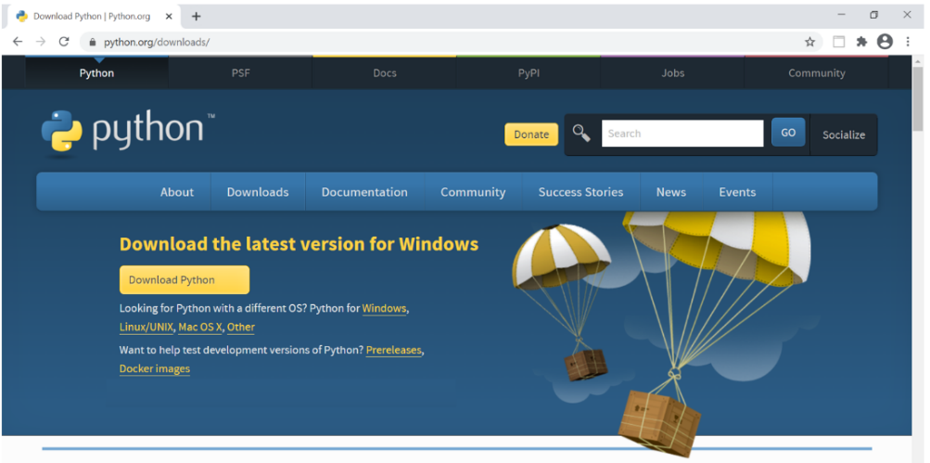
Installing Python
Follow the installation instructions on the Start Here page in Canvas
When you install Python, you get:
The Python Interpreter with built-in Library Functions – e.g. print()
Modules that can be imported as needed (e.g. Math, Random, etc.)
IDLE

Slide 39
Python IDLE
IDLE - Integrated Development & Learning Environment
IDLE is an IDE (i.e. an integrated development environment); like Visual Studio for C#, XCode for Apple’s Swift programming
It let’s you run Python code
It has a built-in debugger which catches any syntax errors
For quick access to IDLE, add it to the Windows taskbar:
In the Windows Search box, type: IDLE
Right click on it and select “Pin to taskbar”

